Slide 1
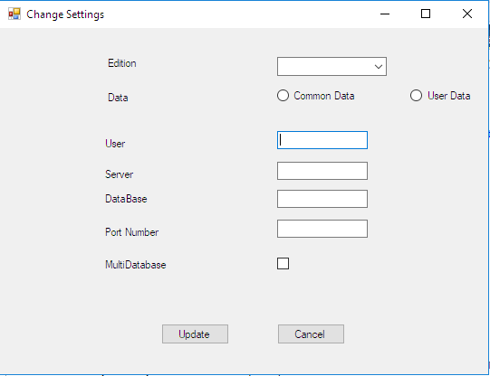
Design

Slide 2
From 1
3 functions
-comboBox1_Mouseclick()
-radiobutton1_Mouseclick()
-radiobutton2_Mouseclick()

Slide 3
ComboBox1_Mouseclick()
Var = comboBob1.Text;

Slide 4
Radiobutton1_Mouseclick()
3 objects
-settings-xmlSettings
-settings1-clsXMLData
-set3-pathset
Flag=1
if (var == "ePlus Basic Edition")
{
xmlPath = @"C:\ProgramData\ePlus Basic Edition"; readPath(set3.xmlPath); }
if (var == "ePlus Proffessional Edition")

Slide 5
radioButton1_Mouseclick
xmlPath = @"C:\ProgramData\ePlus Professional Edition";
readPath(set3.xmlPath); }
if (var == "ePlus Standard Edition")
{
xmlPath = @"C:\ProgramData\ePlus Standard Edition";
readPath(set3.xmlPath);
}
settings = settings1.ReadSettings();
textBox1.Text = settings.userName;
textBox2.Text = settings.serverName;
textBox3.Text = settings.dbName;
textBox4.Text = settings.dbPort;

Slide 6
radioButton2_Mouseclick
3 objects
-settings-xmlSettings
-settings1-clsXMLData
-set3-pathset
Flag=0
f (var == "ePlus Basic Edition")
{
xmlPath = @"C:\Users\Amritha\AppData\Roaming\ePlus Basic Edition";
readPath(set3.xmlPath);
}
if (var == "ePlus Proffessional Edition")
{
xmlPath = @"C:\Users\Amritha\AppData\Roaming\ePlus Professional Edition";

Slide 7
readPath(set3.xmlPath);}
if (var == "ePlus Standard Edition")
xmlPath = @"C:\Users\Amritha\AppData\Roaming\ePlus Standard Edition";
set3 = settings1.readPath(set3.xmlPath);
settings = settings1.ReadSettings();
textBox1.Text = settings.userName;
textBox2.Text = settings.serverName;
textBox3.Text = settings.dbName;
textBox4.Text = settings.dbPort;

Slide 8
Update_Button
2 objects
-xdata –clsXMLData()
- xsettings - xmlSettings();
userName = textBox1.Text;
serverName = textBox2.Text;
.dbName = textBox3.Text;
dbPort = textBox4.Text;
if(flag == 1)
{
if (var == "ePlus Basic Edition")
xmllPath = @"C:\ProgramData\ePlus Basic Edition";
else if (var == "ePlus Proffessional Edition")

Slide 9
Update Button
xmllPath = @"C:\ProgramData\ePlus Professional Edition";
else
xmllPath = @"C:\ProgramData\ePlus Standard Edition";
}
if (flag == 0)
{
if (var == "ePlus Basic Edition")
xmllPath = @"C:\Users\Amritha\AppData\Roaming\ePlus Basic Edition";
else if (var == "ePlus Proffessional Edition")
xmllPath = @"C:\Users\Amritha\AppData\Roaming\ePlus Professional Edition";
else
xmllPath = @"C:\Users\Amritha\AppData\Roaming\ePlus Standard Edition";
}
writesettings(userName, serverName, dbName,.dbPort, xmllPath);

Slide 10
clsXMLData
Struct xmlSettings
public string xmllpath;
New struct pathset
New function-readPath()

Slide 11
Struct pathset
Public string xmlPath

Slide 12
readPath()
xPath = Path;
xmlSettingsFile = xPath + "\\Settings.xml";
pathset x = new pathset();
return x;

Slide 13
Writesettings()
public xmlSettings writesettings(string usr,string svr,string dbs,string prt)
public xmlSettings writesettings(string usr,string svr,string dbs,string prt,string pat)
{
string xmlpath1 = pat;
string xsettingsfile = xmlpath1 + "\\Settings.xml";
}

Slide 14
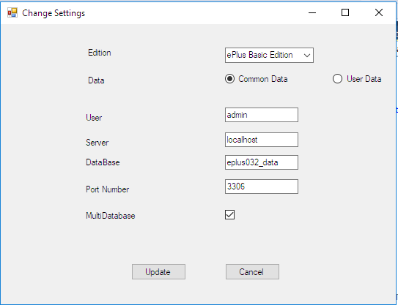
Output

Slide 15
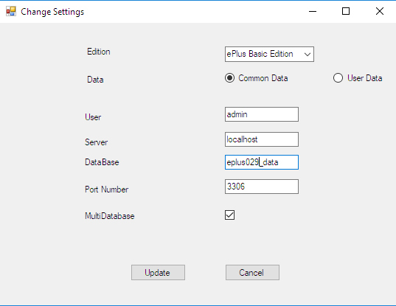
Output

